Slide 1

FOUR PATTERNS OF HEALTHY PEOPLE

Slide 2

Everyone has patterns.
Some get us stuck.

Slide 3

Your strengths got you here.

Slide 4

Desire to please others may create anxiety
Self-discipline can lead to self-centerdness
Loyalty might produce cultural bias
Hard work may drive identity attachments
Selflessness could lead to rescuing and approval
Which of your strengths do you overuse?

Slide 5

How do you know if you’re stuck?

Slide 6
Attachments
Exhausted
Triggers
Addiction
Lack of Discipline
Fear
Over-Functioning
Self-Centerdness
Anxiety/Depression
Recurring Conflict

Slide 7

We default to a fixed narrative.
“I can’t”
“It will always be this way.”
“I’m just so… She’s just so…”
“That’s the way it is.”
“I know this already.”

Slide 8
Joy and impact depend on a transformation narrative.
“I can’t”
“It will always be this way.”
“I’m just so… She’s just so…”
“That’s the way it is.”
“I know this already.”

Slide 9
Joy and impact depend on a transformation narrative.
“I’ll try”
“It will always be this way.”
“I’m just so… She’s just so…”
“That’s the way it is.”
“I know this already.”

Slide 10
Joy and impact depend on a transformation narrative.
“I’ll try”
“I’ll find a way.”
“I’m just so… She’s just so…”
“That’s the way it is.”
“I know this already.”

Slide 11
Joy and impact depend on a transformation narrative.
“I’ll try”
“I’ll find a way.”
“I’m learning to…”
“That’s the way it is.”
“I know this already.”

Slide 12
Joy and impact depend on a transformation narrative.
“I’ll try”
“I’ll find a way.”
“I’m learning to…”
“It could be better.”
“I know this already.”

Slide 13
Patterns are inevitable. Growth is optional.
“I’ll try”
“I’ll find a way.”
“I’m learning to…”
“It could be better.”
“I can keep working at it.”

Slide 14
Where in work/life have you confronted an unhealthy pattern?

Slide 15


Emerging Stronger from Challenges and Uncertainty
4 Patterns
Thoughts
Mental health
Releasing
Welcoming
Relationships
Ego
Operations

Slide 16

Concentrate on the green leaves. Release the red.
…and let the red leaves float by

Slide 17
Emerging Stronger from Challenges and Uncertainty
4 Patterns
Thoughts
Relationships
Discuss vs. avoid
Solid flexible self
Curious rather than defensive
Ego
Operations

Slide 18

1. When I see you doing…
2. I feel…
3. Because I value…
4. So would you consider…
1. Observation
2. Feeling
3. Value
4. Request

Slide 19
Emerging Stronger from Challenges and Uncertainty
4 Patterns
Thoughts
Relationships
Handle rejection
Authentic self
Humility
Ego
Operations

Slide 20

Where could you keep going to the back of the line?

Slide 21
Emerging Stronger from Challenges and Uncertainty
4 Patterns
Thoughts
Relationships
Ego
Operations
Self care & inner work
Accessible & transparent
Develop others

Slide 22

The foundation is a nourished and vigilant mind.

Slide 23
Emerging Stronger from Challenges and Uncertainty
4 Patterns
Thoughts
Relationships
Ego
Operations
Notes:
Poll: Which pattern area represents an important area of growth for you in the coming year?
Healthy thinking
Healthy relationships
Healthy ego
Healthy operations

Slide 24
To have healthier thoughts, relationships, ego, and operations…
Interrogate your thoughts to discern what’s true
Don’t avoid, instead be curious
Solidify who you are apart from others
Manage your energy to be your best self
Key Takeaways

Slide 25
Getting stuck isn’t the end.

Slide 26

We have the ability to grow.

Slide 27
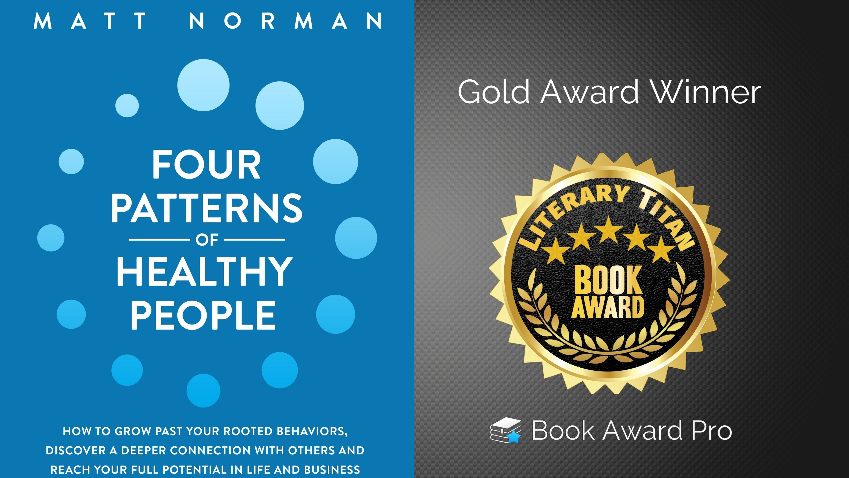

FOUR PATTERNS OF HEALTHY PEOPLE

